Slide 1

PRESENTATION ON Banking System
Namarta Vij
ICS3U
Shuhan Yu, Debbie Cai, Julie Jiang, Mingxi

Slide 2



Table of Content
Introduction about java
Introduction to Eclipse
Explanation to project
First part (Account Management)
Second part (User Management)
Third part (Transaction History &Report Management)
Fourth Part (Admin Management)
Main Method
HTML
Conclusion

Slide 3

1. Introduction about java
Java is a class-based, object-oriented programming language that is designed to have as few implementation dependencies as possible. Java was developed by James Gosling at in May 1995 .
Java is known for its simplicity, robustness, and security features, making it a popular choice for enterprise-level applications.
In this project, all the codes we wrote are written in Java.

Slide 4
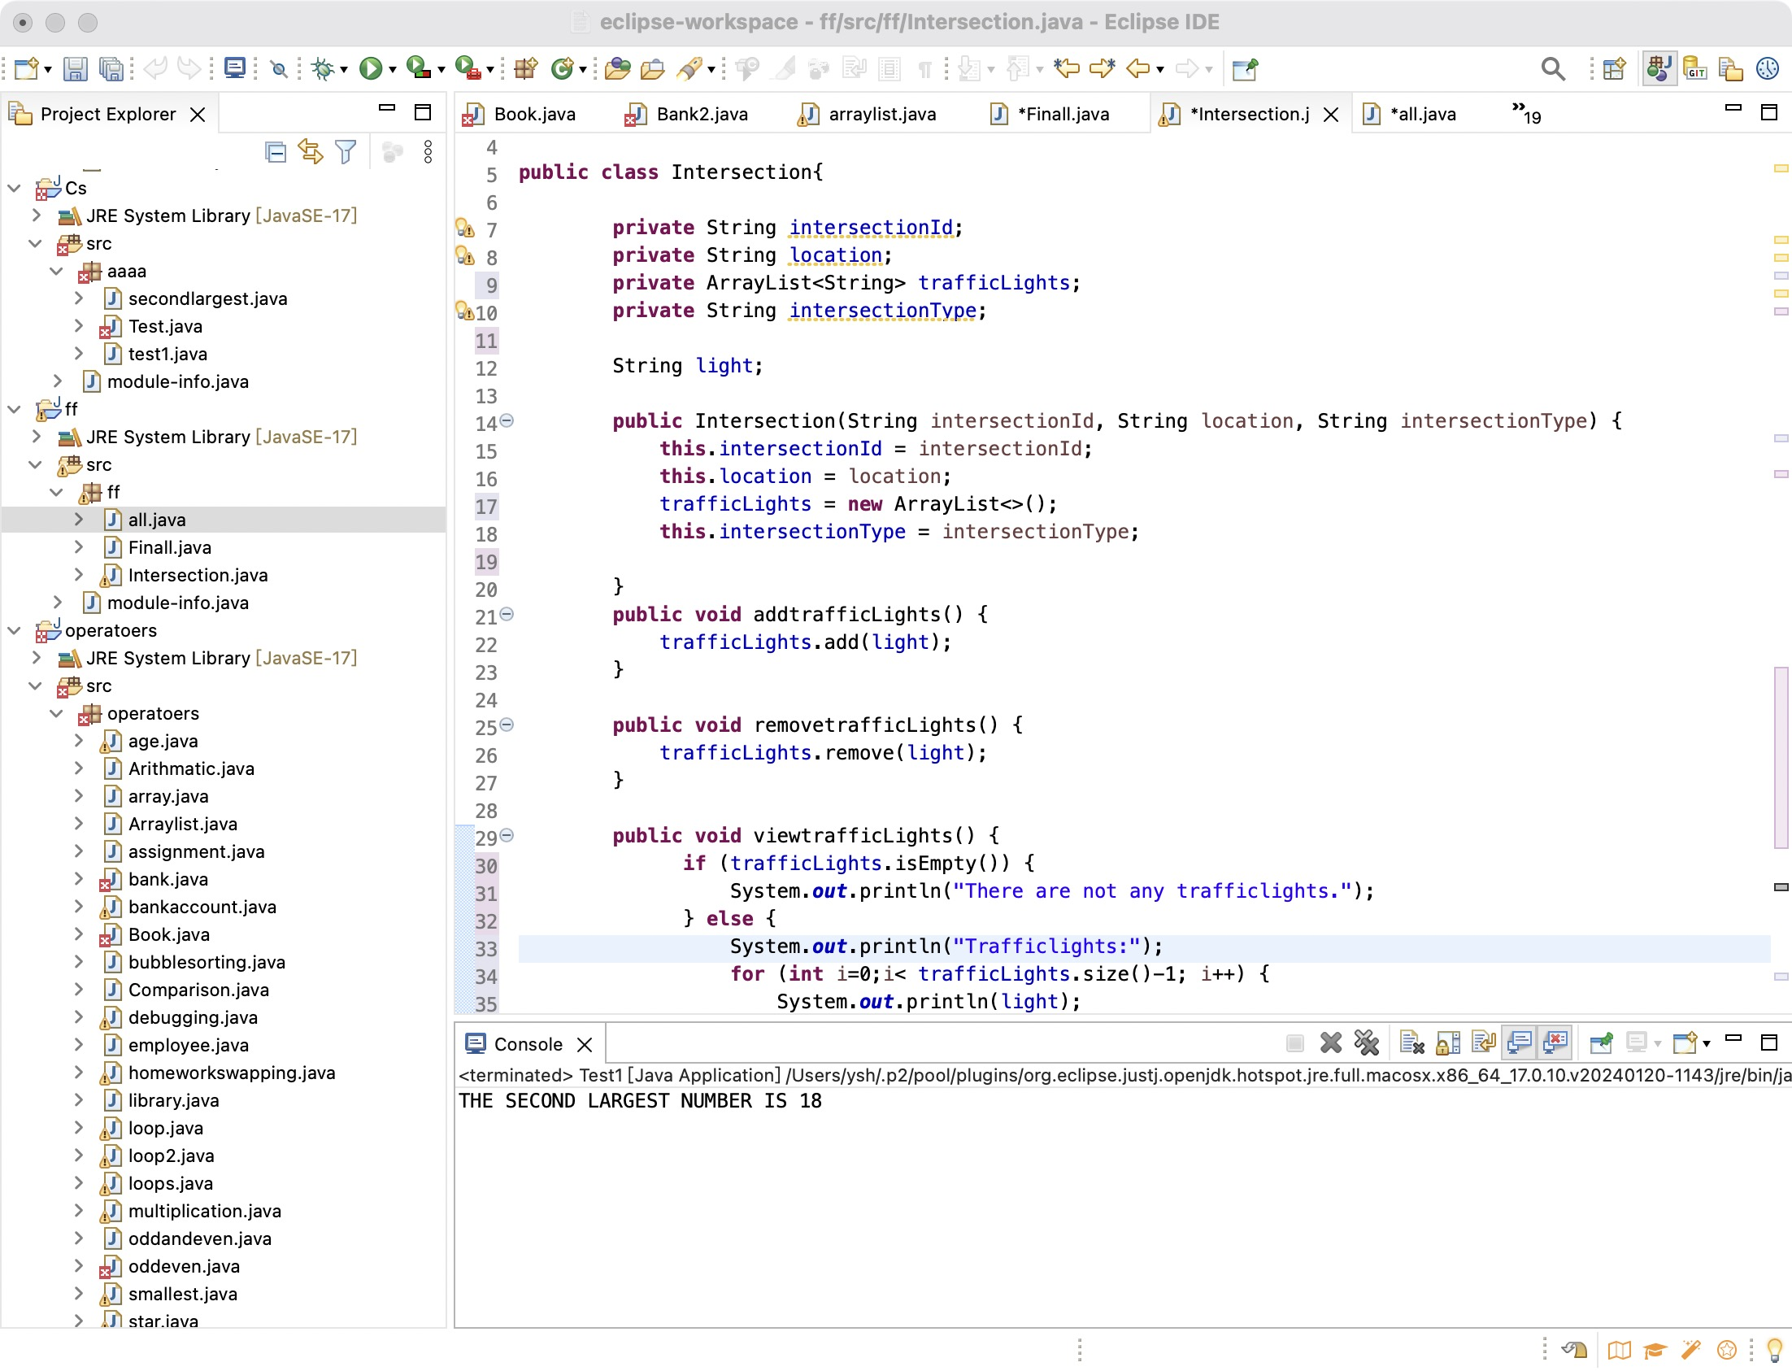
2. Introduction to Eclipse
Eclipse is a free and open-source integrated development environment (IDE). It is known for its powerful code editing, debugging and project management functions, providing intelligent code completion, real-time error detection and version control integration, greatly improving development efficiency.
In this project, all the Java codes we wrote and run were written in the eclipse.

Slide 5
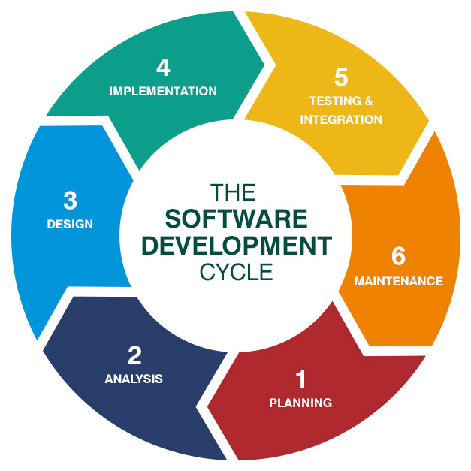
3. Explanation to project
•Coding
Part 1 – Julie
Part 2 – Shuhan
Part 3 – Mingxi
Part 4 – Debbie
All -- Debbie
•HTML
Mingxi
•Report
Julie, Shuhan, Debbie
•PPT
Shuhan

Slide 6
3. Explanation to project
This project is a banking system that allows users to create accounts, deposit and withdraw money, and check their balances. The system will also allow users to transfer funds between accounts.
First part: Account Management
Create account, View balance, Deposit, Withdraw, Transfer funds
Second part: User Management
Register User, Login User, View Account Details, Update Account Info
Third part: Transaction History & Report Management
Add Transaction, View Transaction History, Generate Report
Fourth part: Admin Management
View All Accounts, Block User, Manage Transactions

Slide 7
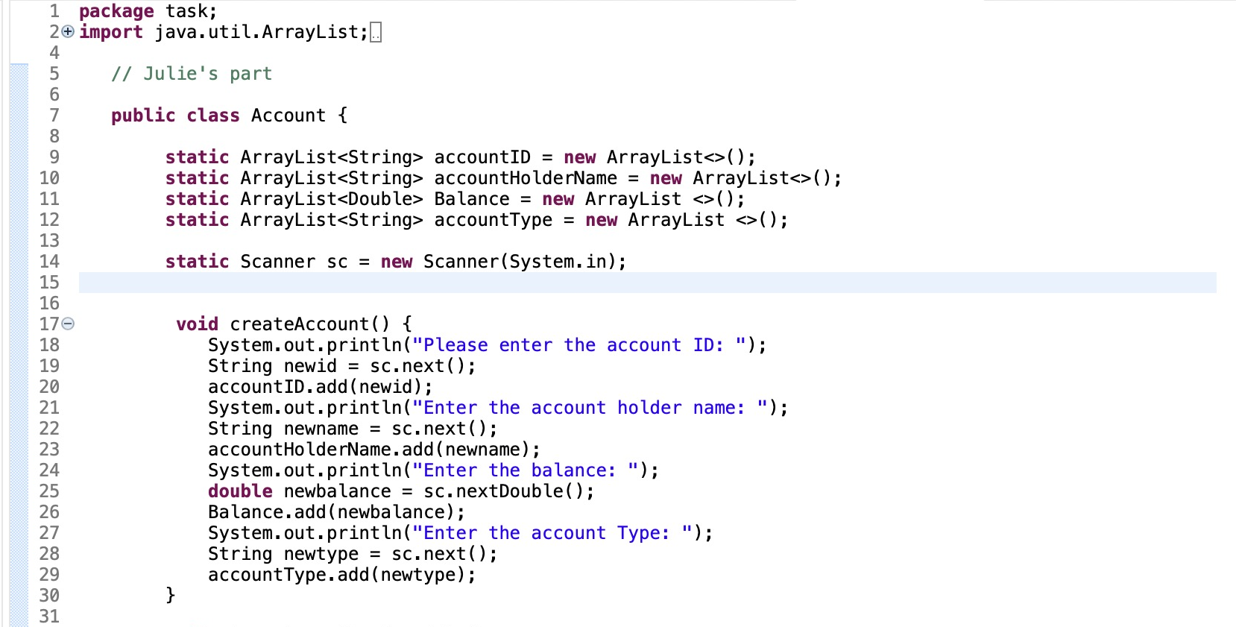
3. Explanation to project –- Account Management (1
Create Account
Arraylist
Scanner
String
System.out.println

Slide 8
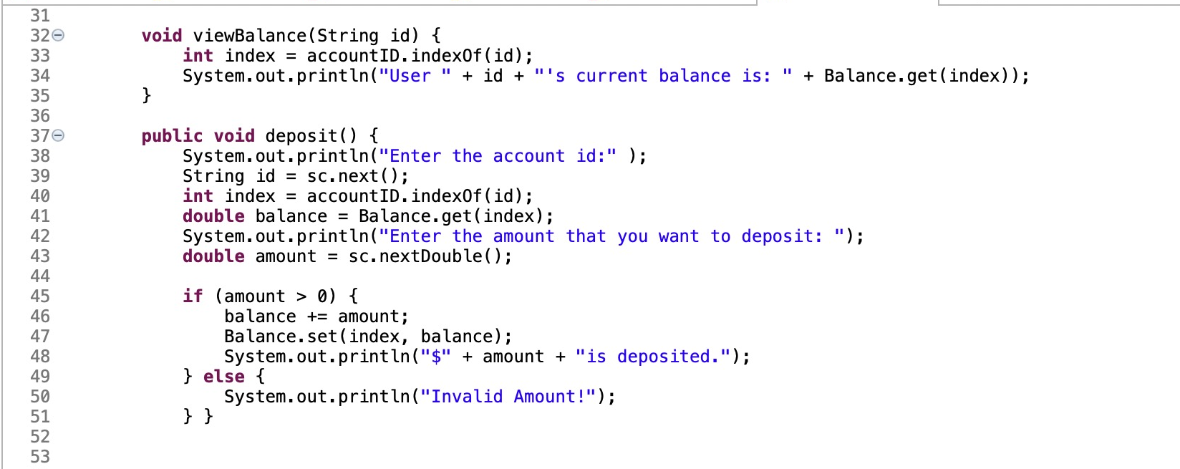
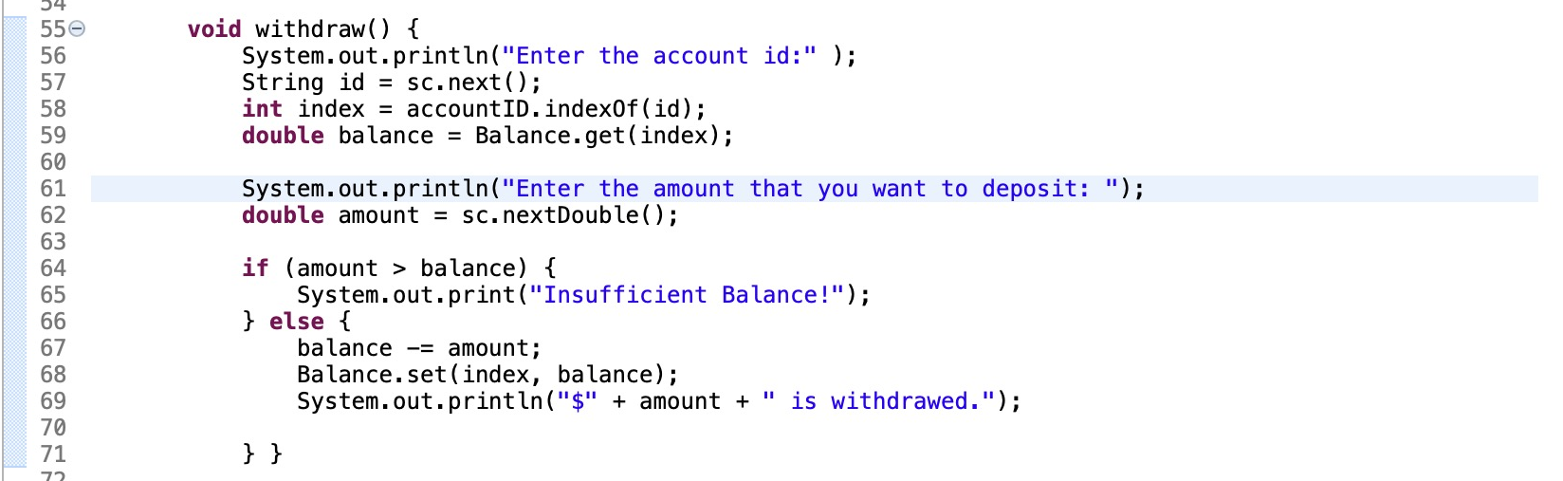
3. Explanation to project –- Account Management (1
View Balance, Deposit, Withdraw
index
double
if-else

Slide 9
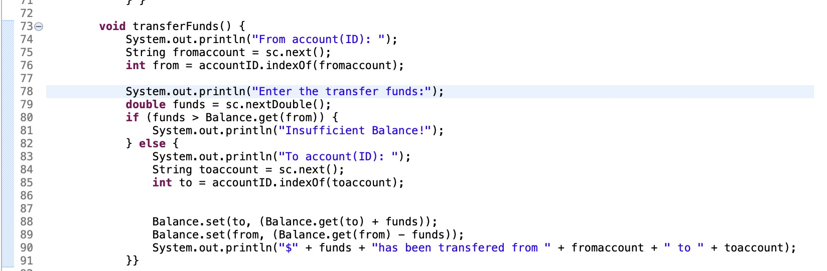
3. Explanation to project –- Account Management (1
Int
Get
Set
TransferFunds

Slide 10
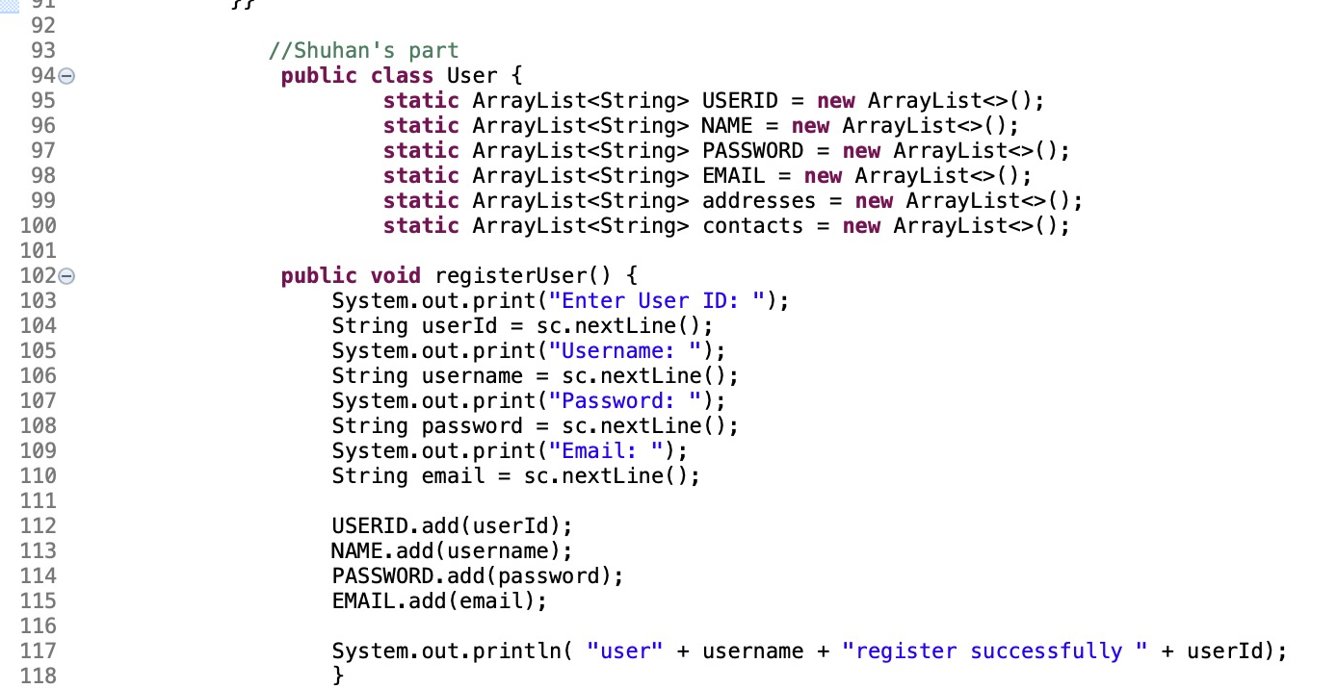
3. Explanation to project –- User Management (2
Register user
Arraylist
String
Scanner
System.out.print

Slide 11
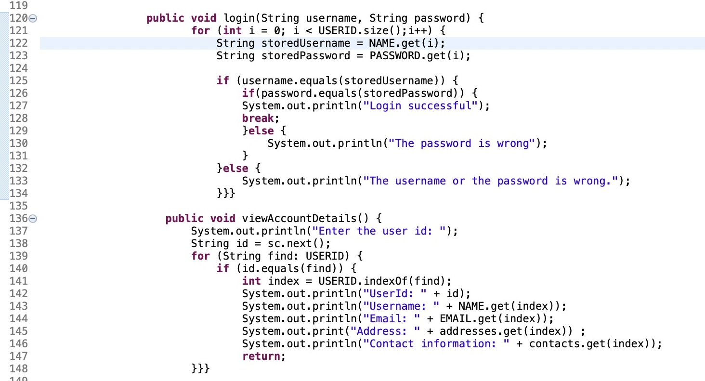
3. Explanation to project –- User Management (2
Login, View account details
For-loops
If-else
Equals
Index
A:b
Repeat all elements to USERID which is equals to ”find”.

Slide 12
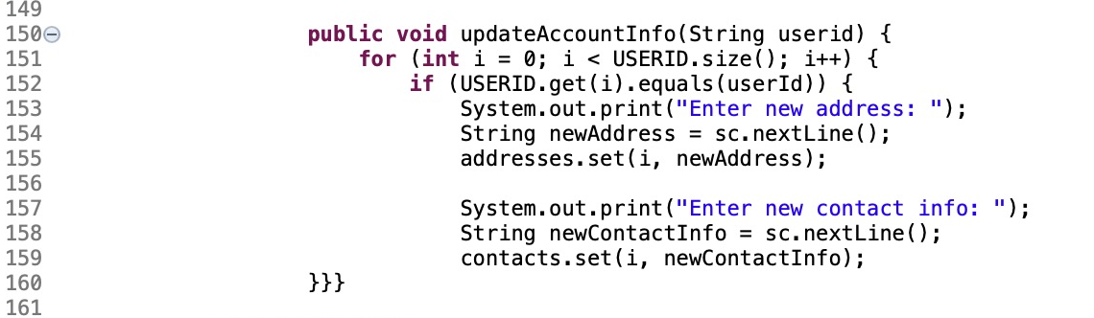
3. Explanation to project –- User Management (2
Register user
Get
Set

Slide 13
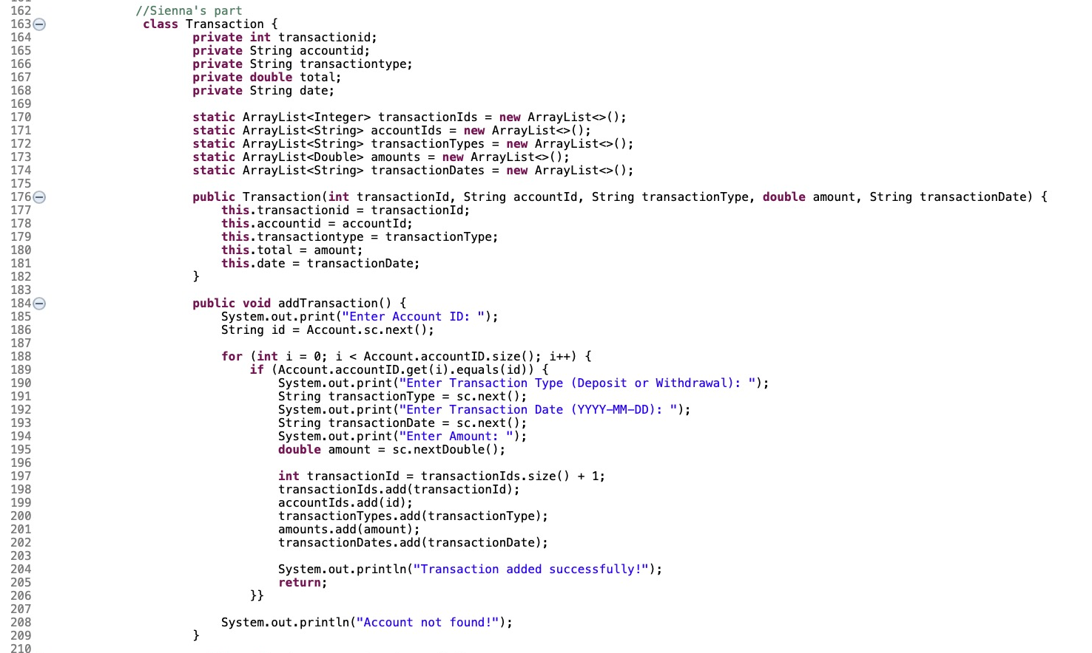
3. Explanation to project -–Transaction History &Report Management (3
Add Transaction
Arraylist
This
String
For-loops
If-else
System.out.println
Private
Int
Double

Slide 14
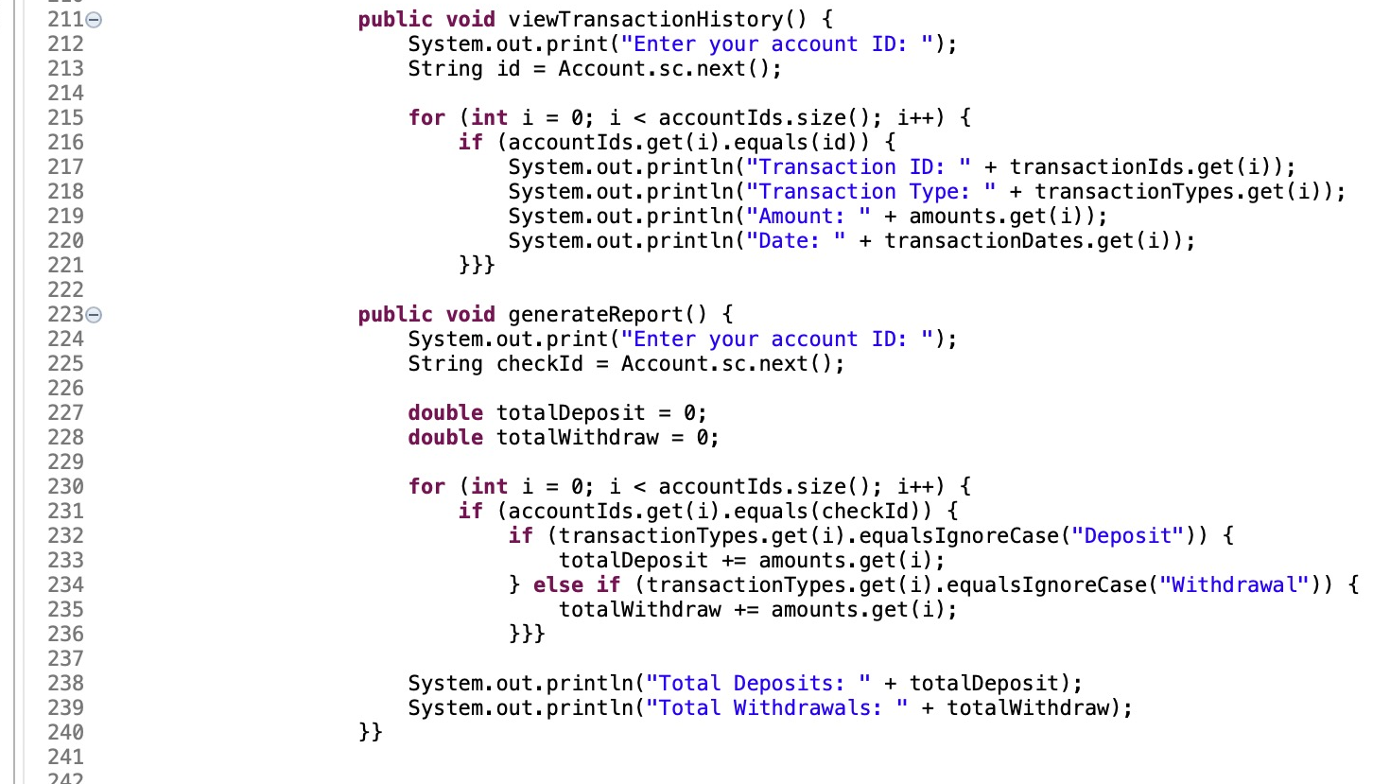
3. Explanation to project -–Transaction History &Report Management (3
View transaction history, Generate report
Equals
Get

Slide 15
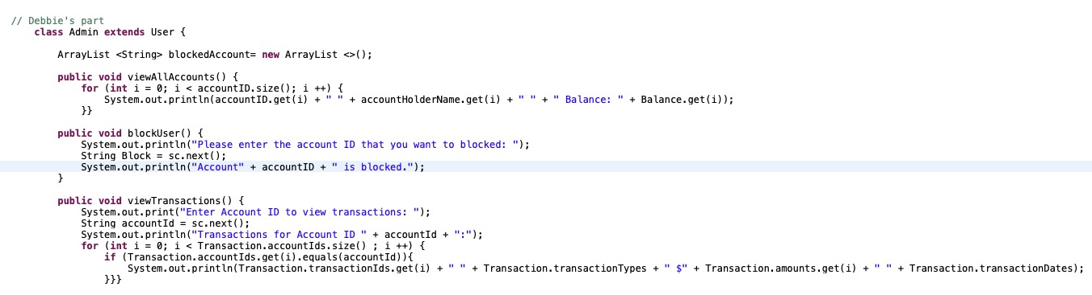
3. Explanation to project –- Admin Management (4
View all accounts, Block user, View transactions
Extends
For-loops
If-else
Equals
Get

Slide 16
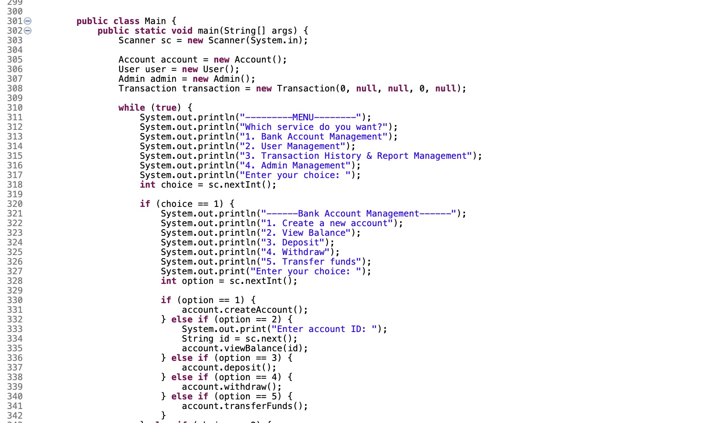
3. Explanation to project -- ALL
Main Method

Slide 17
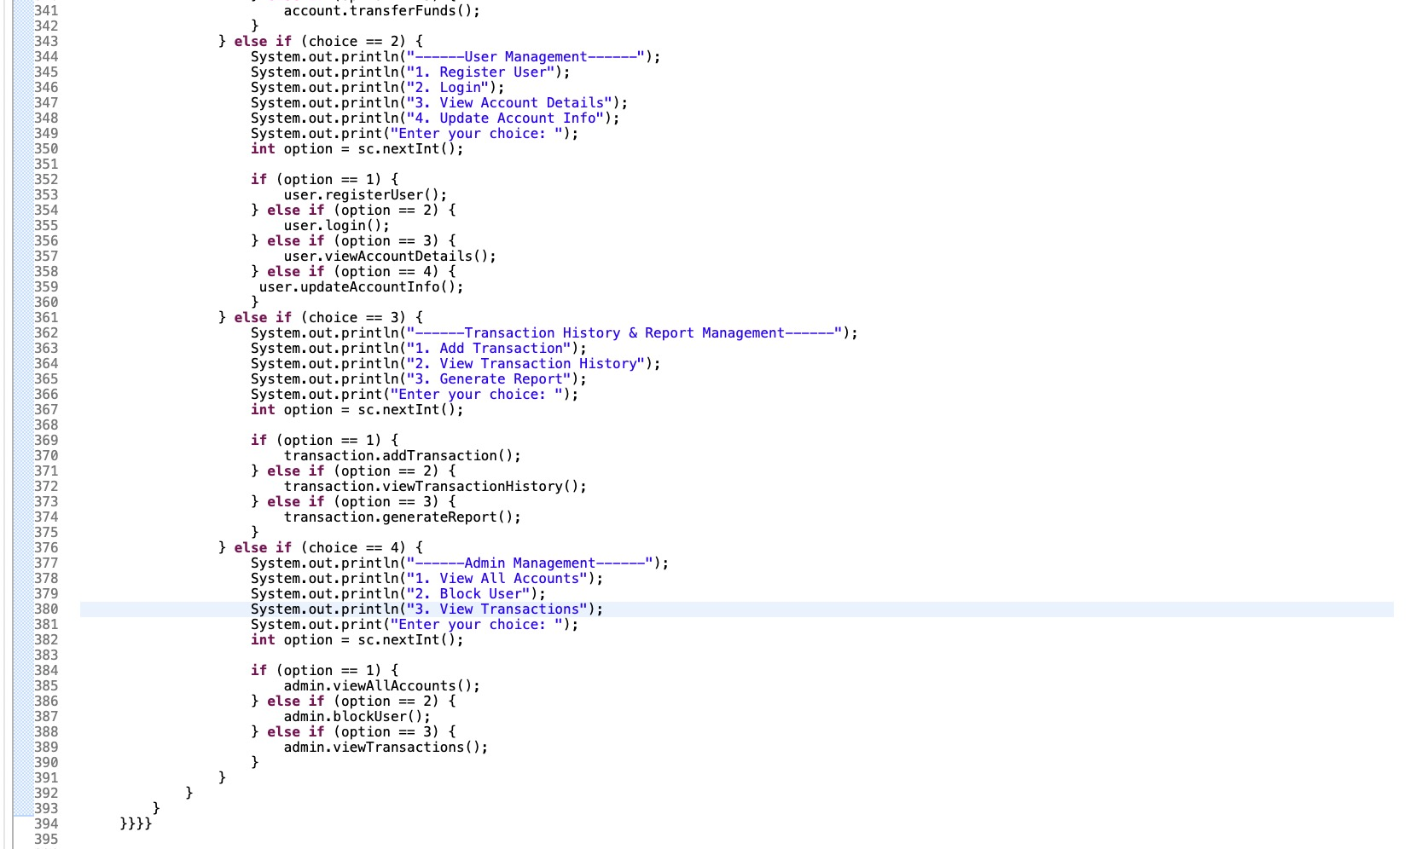
3. Explanation to project -- ALL
Main Method

Slide 18
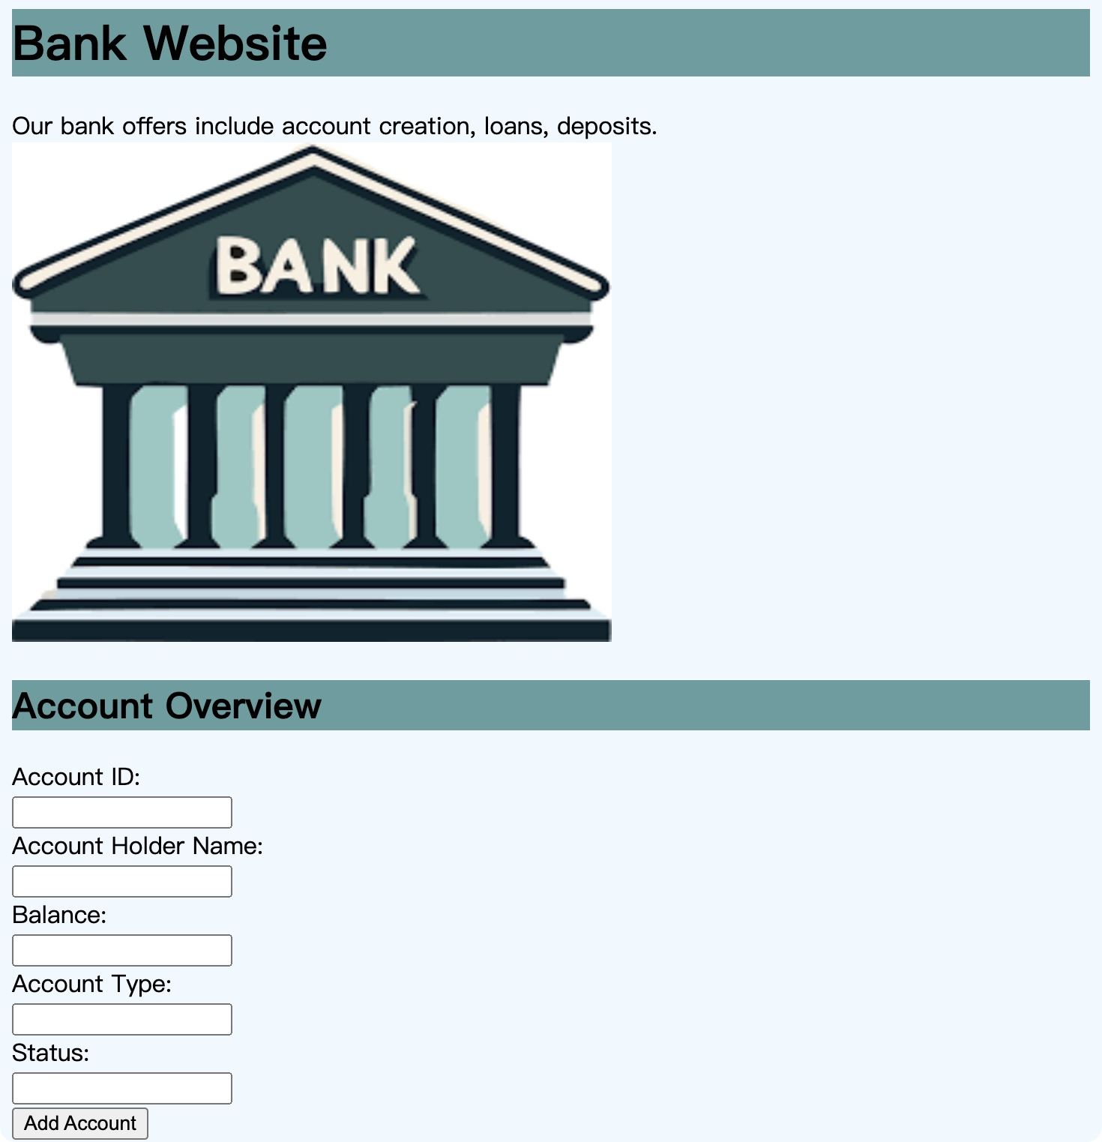
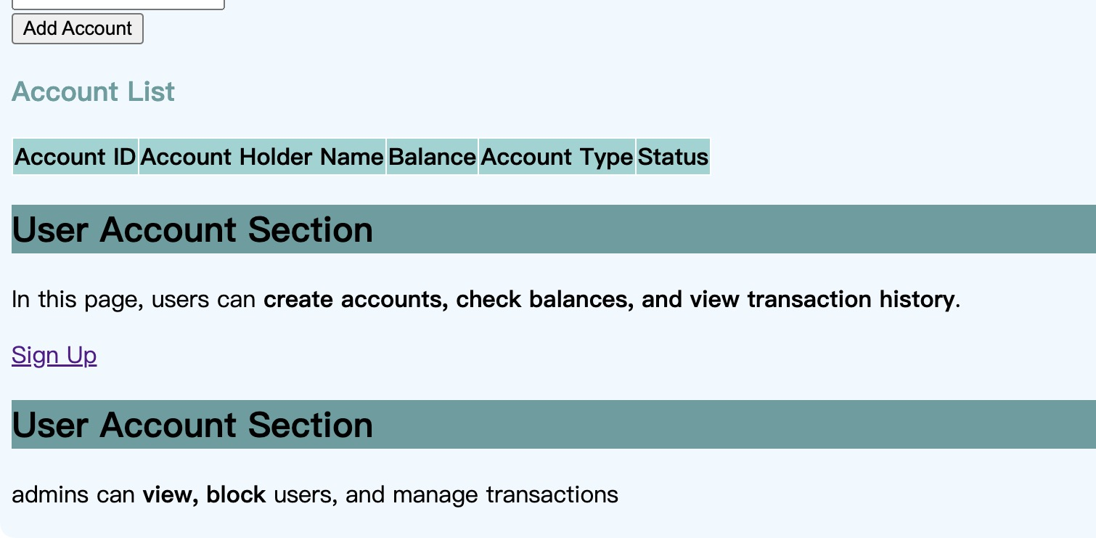
4. HTML
https://bank-mangement.w3spaces.com/saved-from-Tryit-2025-03-05-b88q0.html

Slide 19
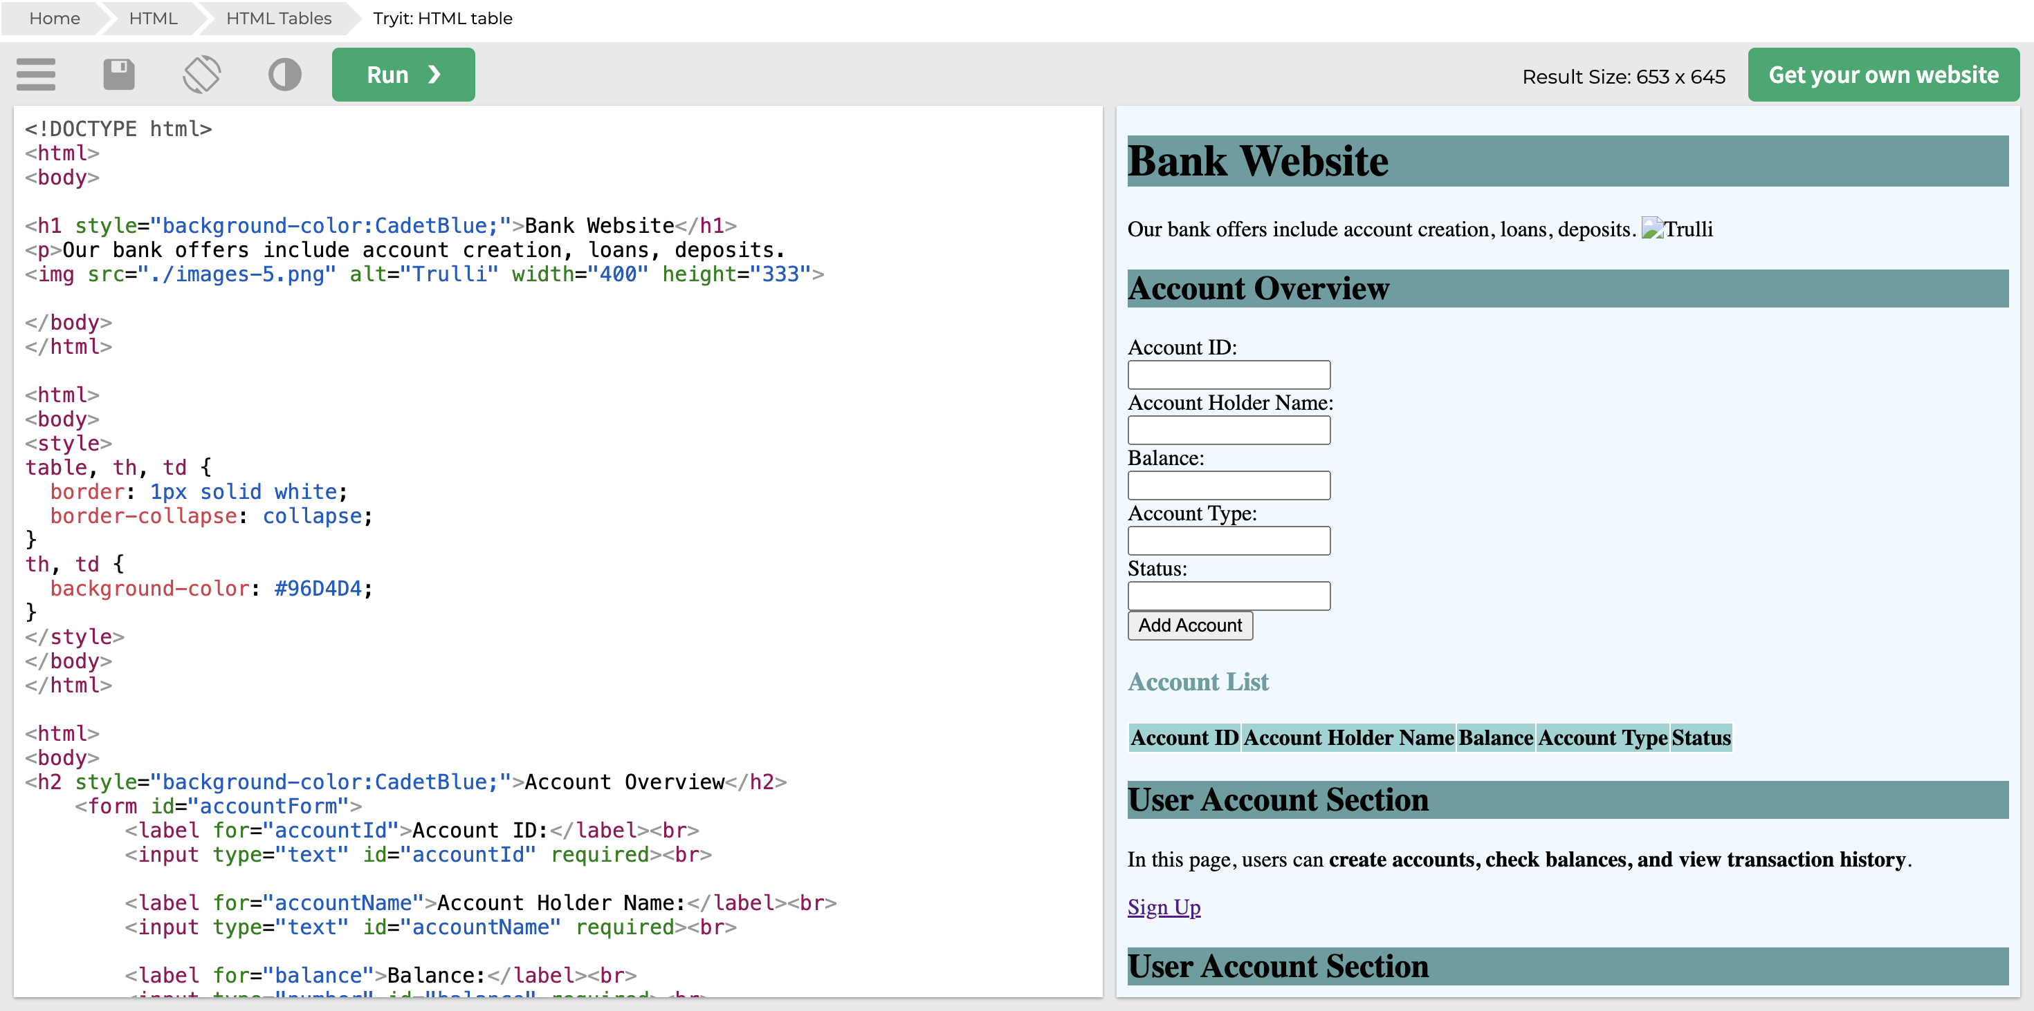
4. HTML

Slide 20
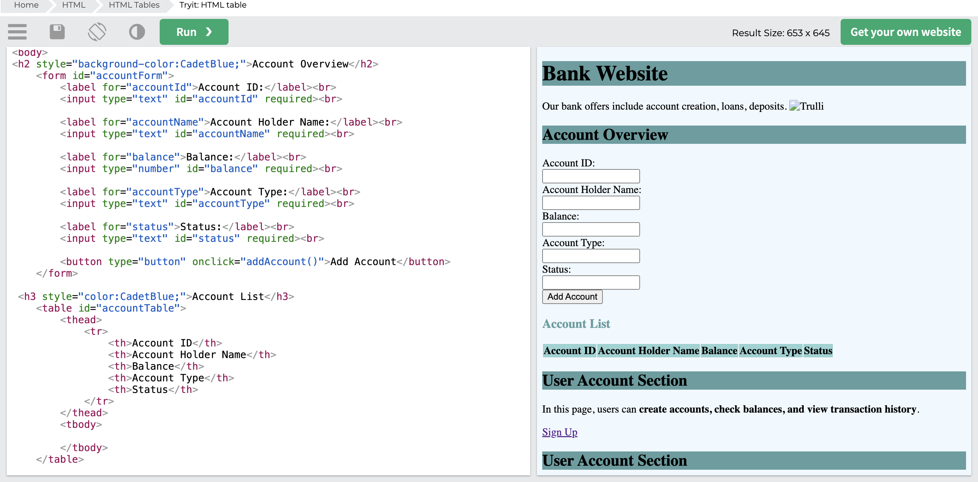
4. HTML

Slide 21
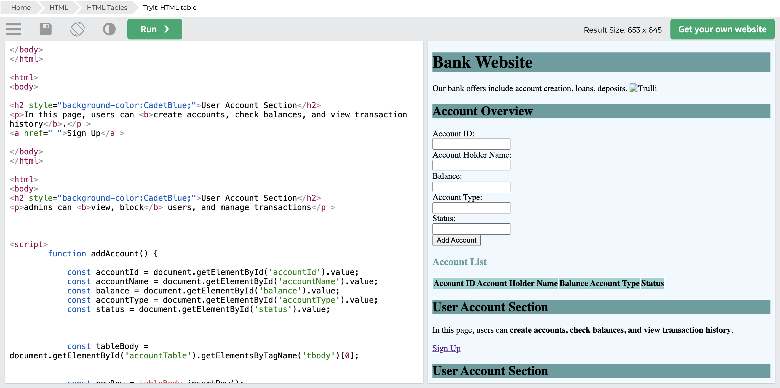
4. HTML

Slide 22
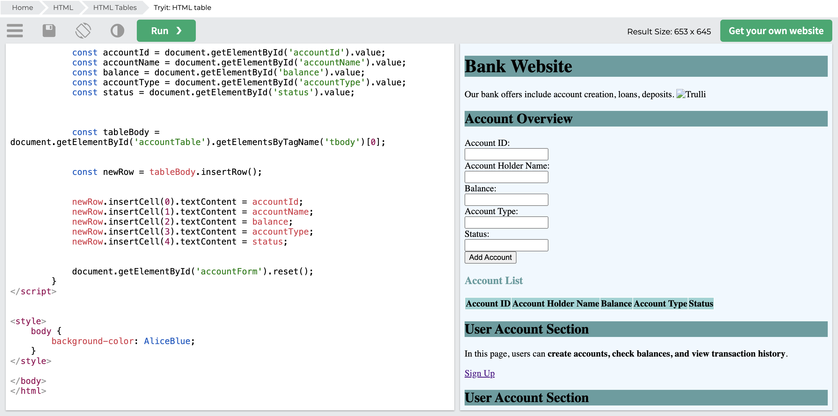
4. HTML

Slide 23
5. Conclusion
This Banking System project demonstrates key object-oriented programming concepts like classes, inheritance, encapsulation, for loops, index, and ArrayLists in Java. The system allows users to create accounts, deposit, withdraw, transfer funds, and manage transactions securely. It includes user authentication, transaction history tracking, and admin controls for managing accounts. This project provides a basic functional model for handling banking operations efficiently.

Slide 24

THANKS

